Slide 1

Modelling Mitochondrial Liver Toxicity With
Oxygen and Cell Density Gradients William Xingze Xu, University of Cambridge
Supervised by: Dr Giovanni Di Veroli, Dr Aydar Uatay, AstraZeneca

Slide 2
Liver safety is a major risk for drug development
Drug-induced liver injury (DILI) leads to 22 % clinical trial terminations and 32 % market withdrawals
Attrition with regulators / extra clinical trials can be costly
Pre-clinical screening of liver toxicity is needed
Different mechanisms of liver toxicity include:
mitochondrial dysfunction, bile acid-induced apoptosis, oxidative stress by reactive oxygen species (ROS)

Slide 3
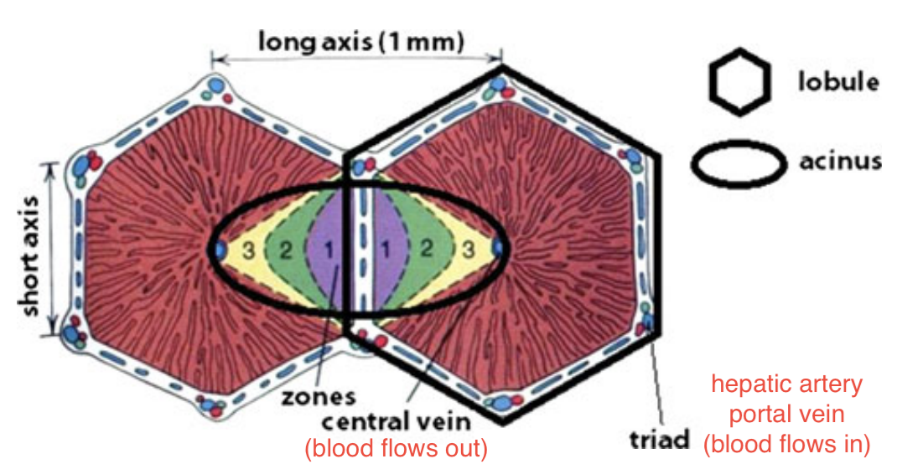
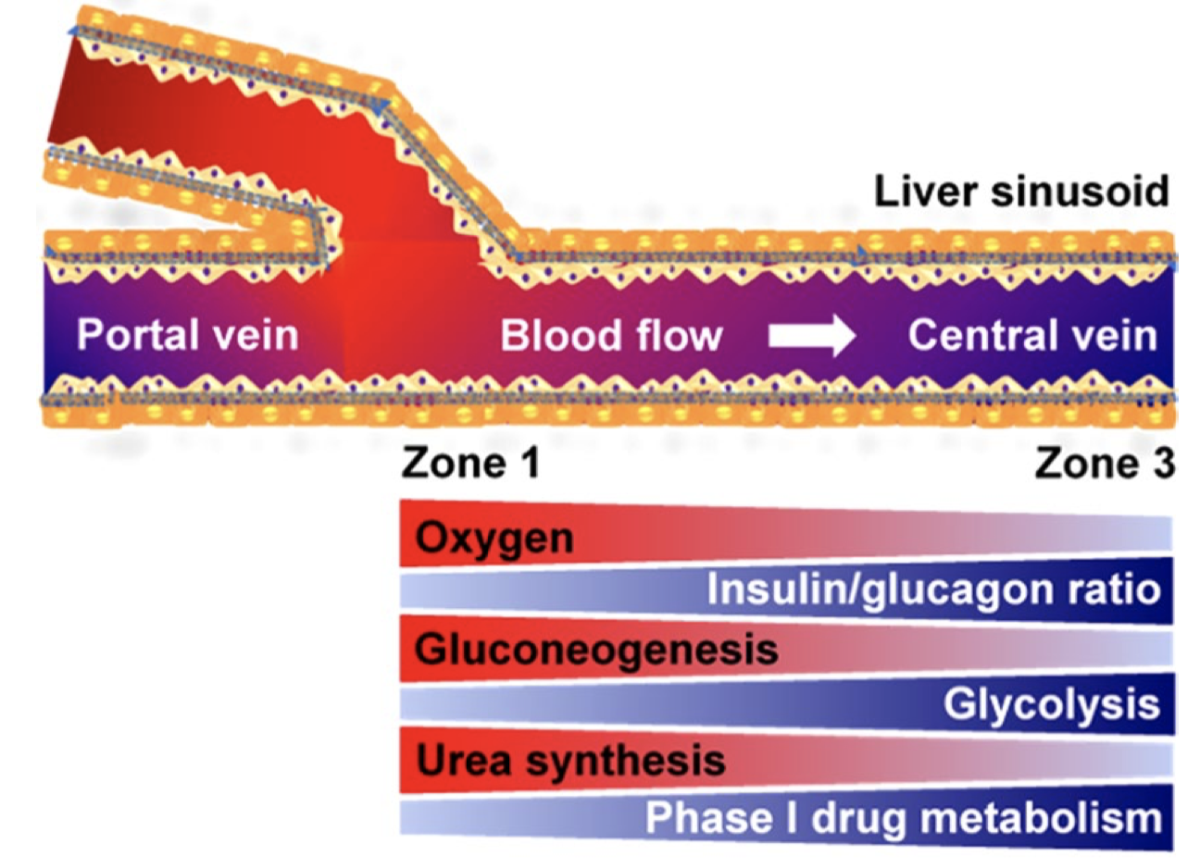
Liver is inhomogeneous
3 zones exist in each liver acinus: periportal (1), transitional (2), perivenous (3)
Liver zonation is driven by gradients of oxygen, nutrients, xenobiotics, morphogens...
Each zone has different functions: 1 for protein synthesis, 3 for bile acid synthesis
Godoy 2013
Kang 2018

Slide 4
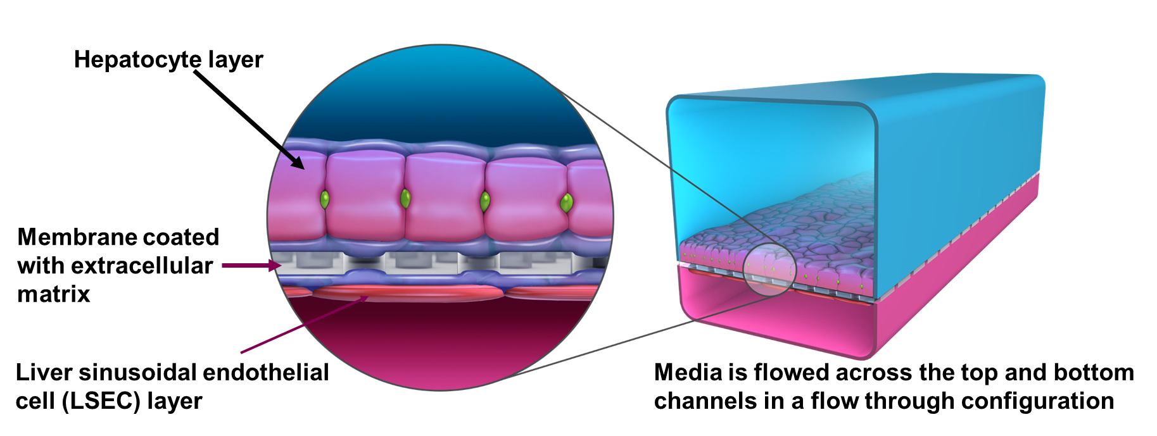

Various models of DILI have been developed
In-vitro models include: spheroid culture system, organoid, micro-physiological system (MPS): liver-on-a-chip
In-silico models include: COMSOL Multiphysics simulation of in-vitro models, DILIsym by Simulations Plus
1mm
1mm
200 µM
Peel 2019. Device from Emulate Inc.

Slide 5
An flexible in-silico DILI model that combines advantages of COMSOL and DILIsym can be useful
We want a model that predicts DILI based on mechanism and dose-response curve of an unknown drug
In addition, We want to preserve as much mechanistic and spatiotemporal information as possible, which can be compared against physiological data for validation and even reveal extra insights
We prefer a flexible design or framework that can simulate DILI in both human liver and MPS, providing information to guide the design of MPS and interpret its results

Slide 6
Systems Model of Drug-Induced Liver Injury (SysDILI): in-silico DILI model developed in this project
Computational: SysDILI was constructed entirely from published data
Modular: SysDILI consists of 4 interacting submodels
Continuous Spatiotemporal Gradients: no artificial zonation was used
Each domain was modelled as continuum
SysDILI currently focuses on mitochondrial toxicity
SysDILI currently models a sinusoid functional unit of human liver,
but it is customisable and may be adapted to complement MPS

Slide 7
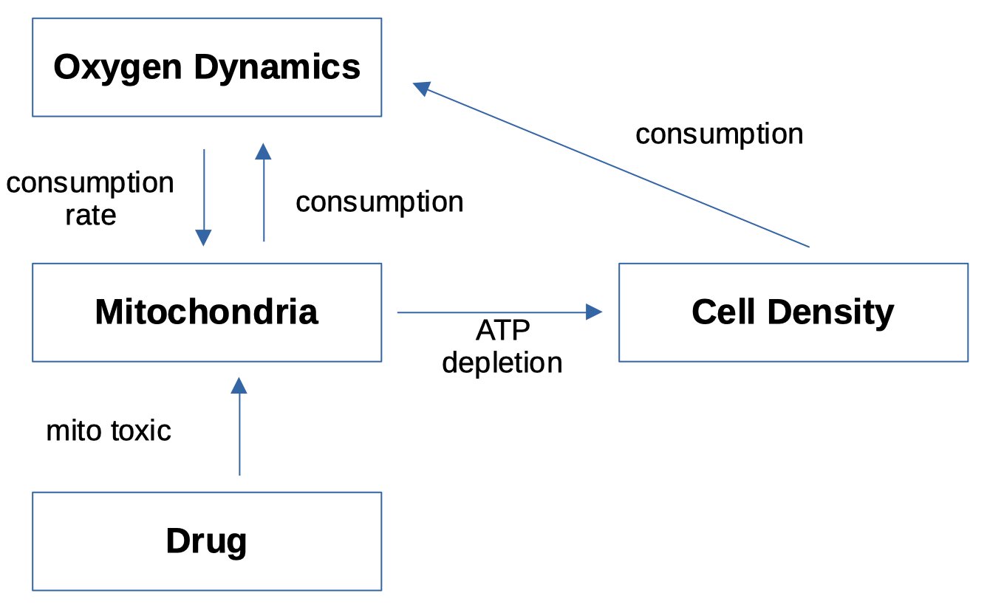
Schematic diagram of structure of SysDILI

Slide 8
Various methods were used to build SysDILI
Each submodel was developed and tested independently
All simulations, optimisations and visualisation were done in MATLAB
ODE systems for mitochondria, cell density and drug were solved by ODE15s
PDE systems for oxygen and drug were solved by numerical scheme: Crank-Nicolson for diffusion and the upwind scheme for convection
Part of SysDILI is reverse-engineering of previous research, but there are also several original advances in SysDILI

Slide 9
Construction of the Four Submodels of SysDILI

Slide 10
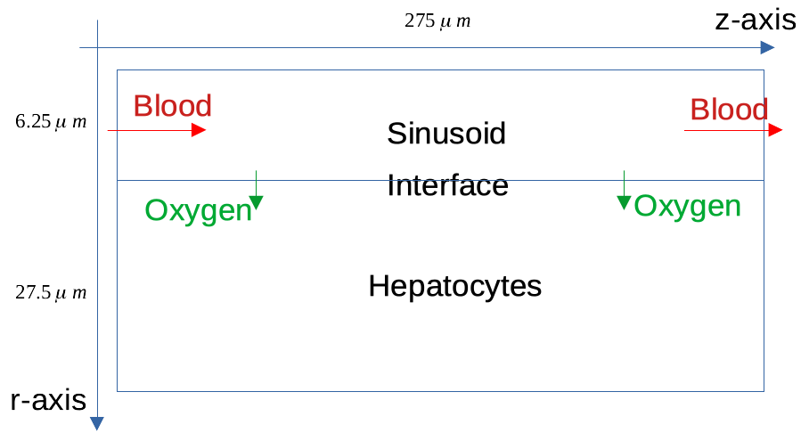
Oxygen Submodel defines the domain setup of SysDILI
The design is based on Krogh model of capillary
3D cylindrical coordinate with rotational symmetry about z-axis was used
There are 3 domains: sinusoid, hepatocytes and their Interface
Oxygen supplied from blood is classified into 2 types: plasma oxygen and haemoglobin oxygen
Plasma oxygen diffuses across the interface
and gets consumed by hepatocytes

Slide 11
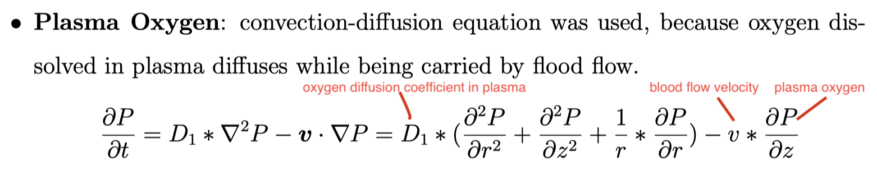
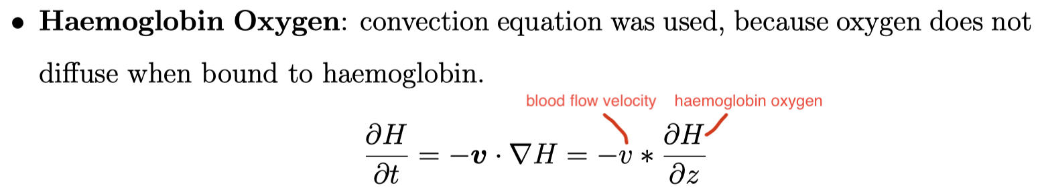
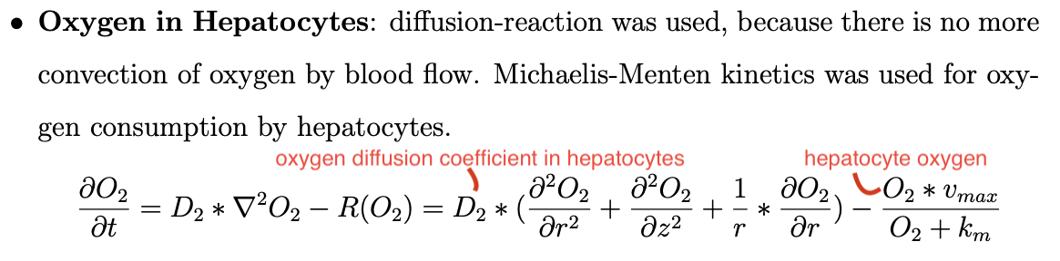
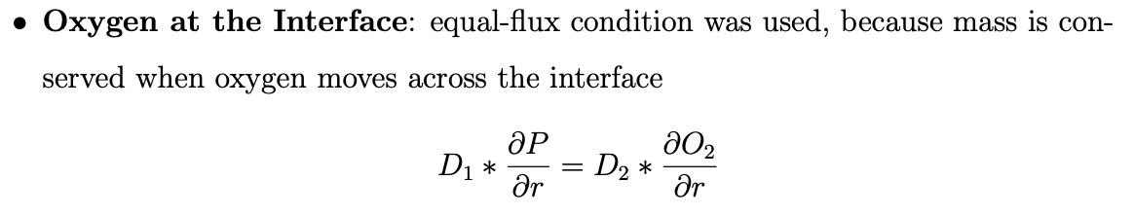
Oxygen Submodel is defined by 5 equations

Slide 12
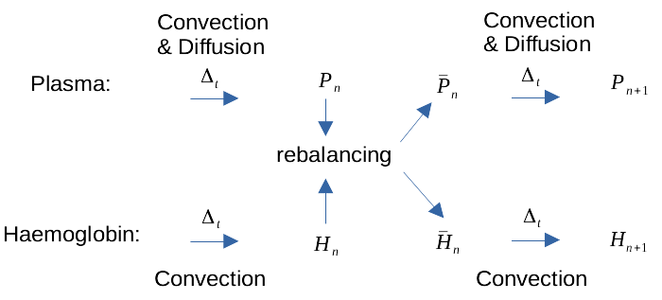
Haemoglobin and plasma oxygen are rebalanced at the end of each time step
Oxyhemoglobin dissociation is much faster than oxygen diffusion in plasma
Assumption in the discretised scheme is haemoglobin releases oxygen and
the equilibrium is instantaneously reached at the end of each time step
This process is termed rebalancing

Slide 13
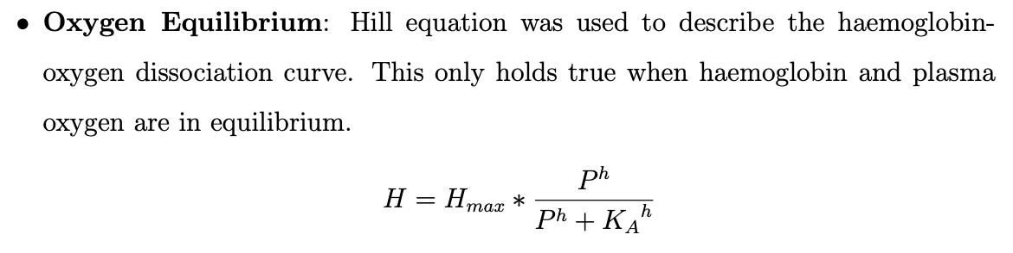
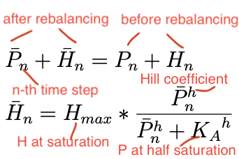
Discretisation

Slide 14
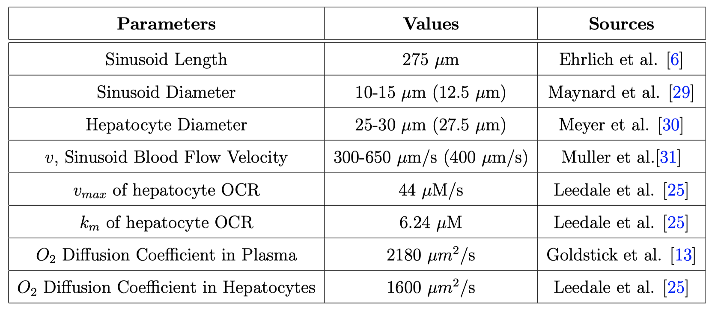
Human physiology data were used to parameterised Oxygen Submodel

Slide 15
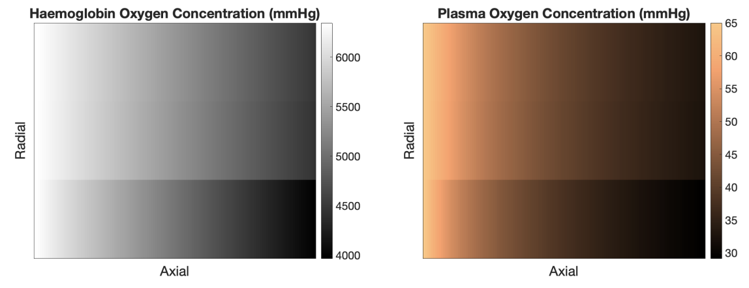
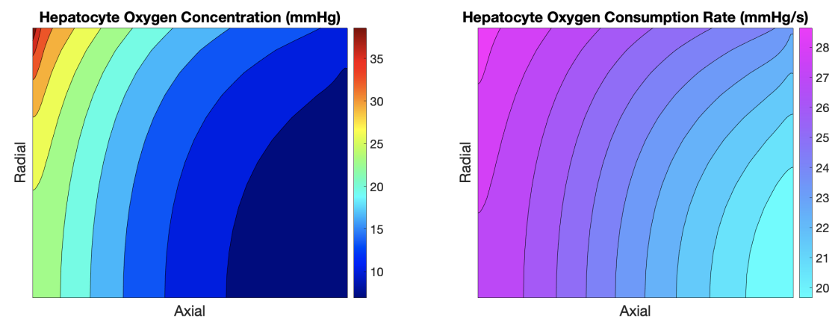
Plots of typical output of Oxygen submodel
Sinusoid Domain
Hepatocytes Domain

Slide 16
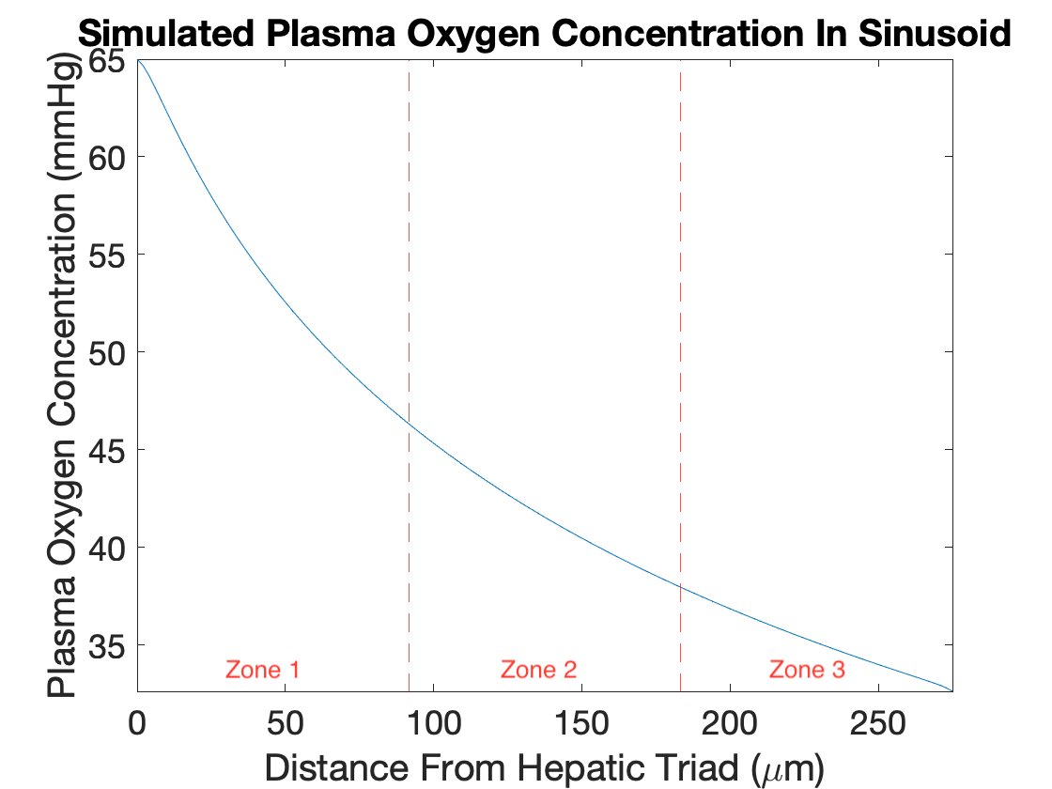
Zonal plasma oxygen concentration validates the submodel
Oxygen input boundary condition at the entrance of zone 1 was fixed to 65 mmHg as in the human liver
Desired result of approximately 35 mmHg was obtained in the simulation outcome of zone 3, as in the human liver

Slide 17
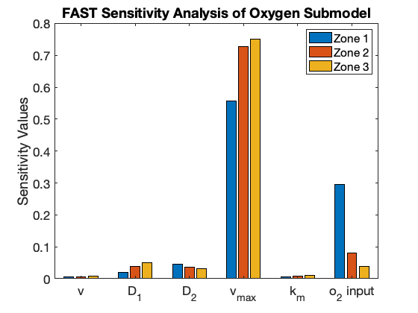
Sensitivity analysis of oxygen concentration to the parameters shows the importance of v_max of OCR rate
FAST global sensitivity analysis was used for parameters within specified ranges
The subject of analysis is the average oxygen concentration in each zone
O2 input is the boundary condition of plasma oxygen at the entrance of sinusoid
Significance of Oxygen Submodel is confirmed. v_max is the only parameter that changes to variable when Mitochondria Submodel is added

Slide 18
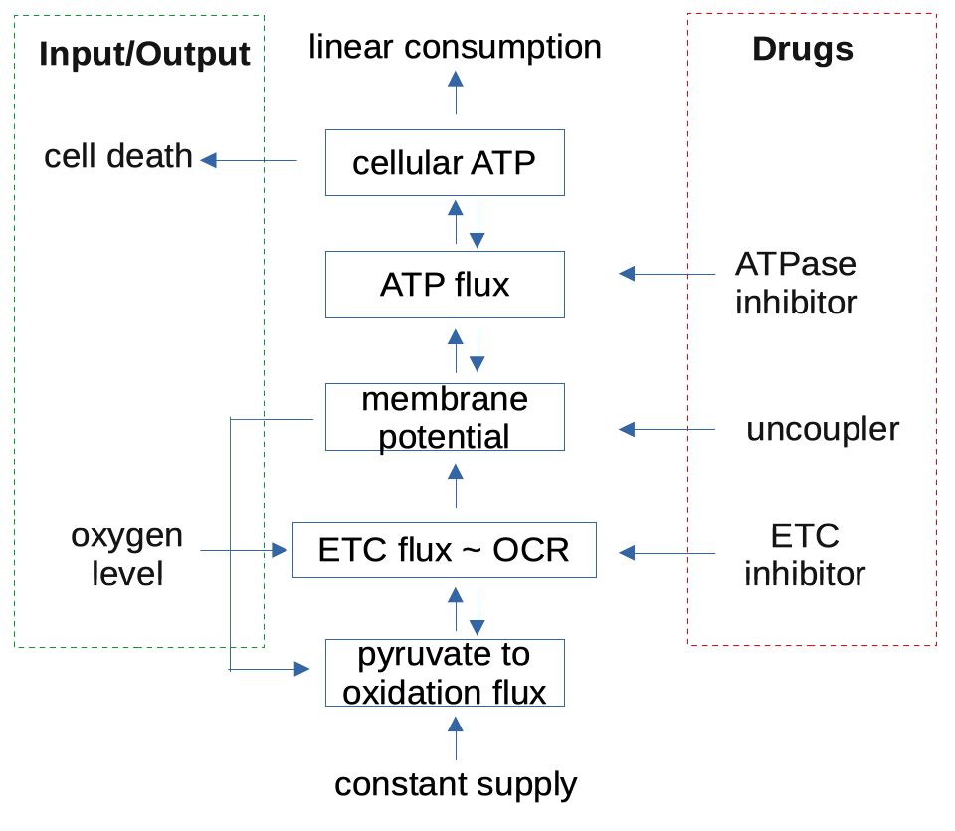
Mitochondrial Submodel Was Adapted and Simplified From MITOsym in Yang 2015 et al.
3 toxicity mechanisms are modelled
Input of the submodel is oxygen level, which affects OCR rate
Output of the submodel is cell death due to depletion of cellular ATP
Upward arrows are movement of flux
Downward arrows are feedback inhibition

Slide 19
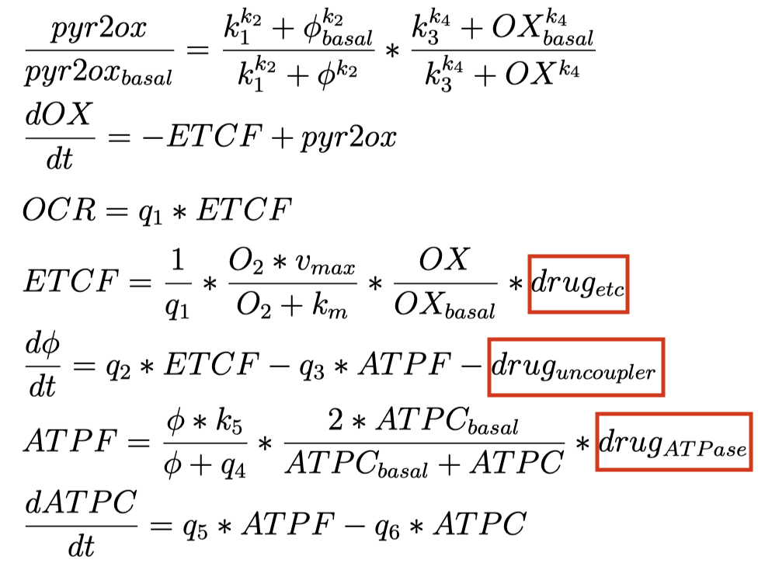
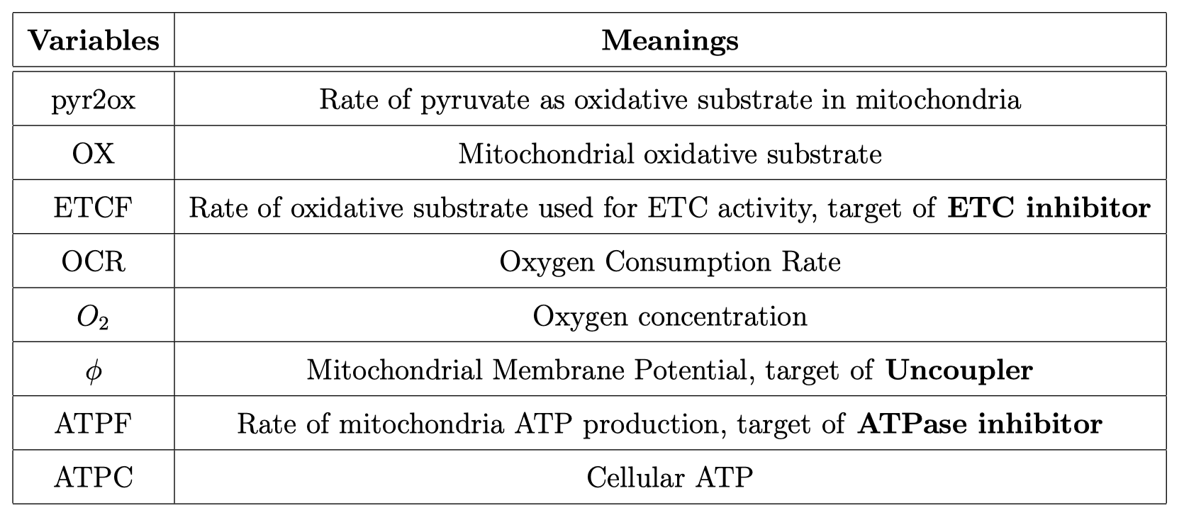
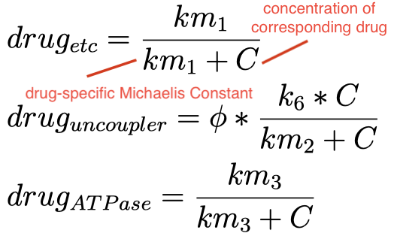

Slide 20
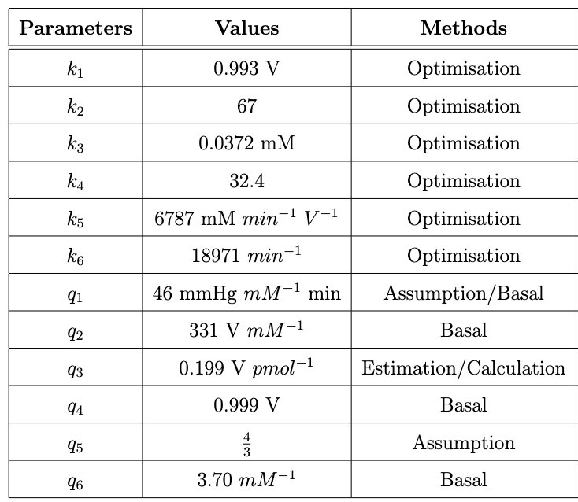
Parameterisation of Mitochondria Submodel
k1,…, k6 are fitted by drug-response data from Yang 2015
( OCR, MMP, ATPC of 3 types of drugs )
q1,…, q6 are coefficients estimated from physiological data and basal state data

Slide 21
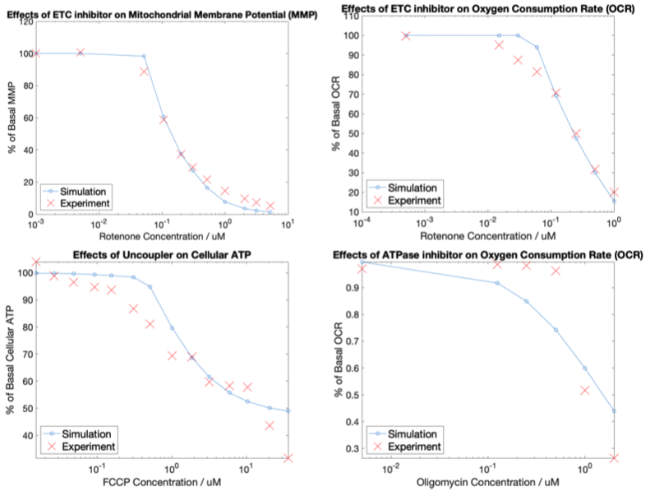
Model was fitted by Global Optimisation Toolbox in MATLAB: interior point method + multi-start. Selected goodness-of-fit plots are shown

Slide 22
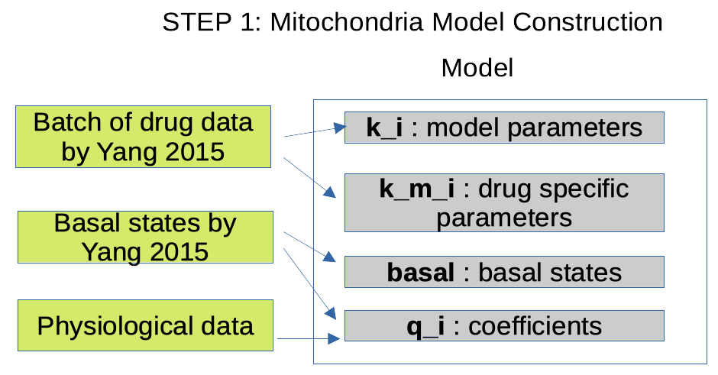
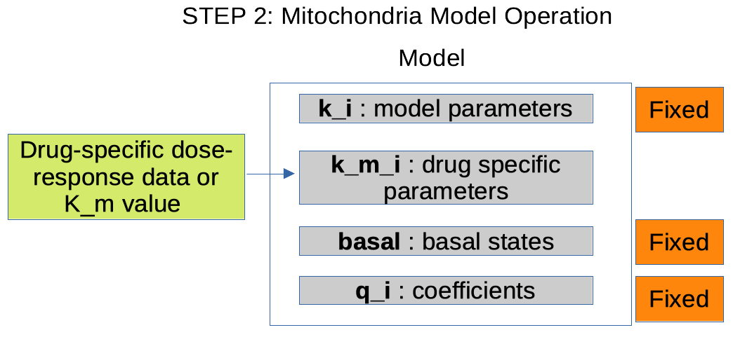
{k_m} are fitted by experimental data when the submodel deals with new drug
k_m1, …, k_m3 are drug-specific, determined by optimisation using dose-response data
Contrary to Yang 2015, these {k_m} are just nominal Km determined from experimental Km by optimisation, because the other variables might also change with drug dose, due to the complexity of the system

Slide 23
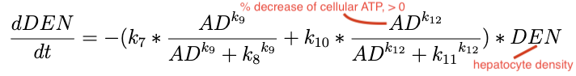
Cell Density Submodel consists of two Hill equations
The design is a simplification from the corresponding one in DILIsym
Nature of the design is black-box, but it was inspired by energy-dependent apoptosis and necrosis
Currently no growth term is included, so only acute liver injury in short term (~12 hours) is modelled

Slide 24
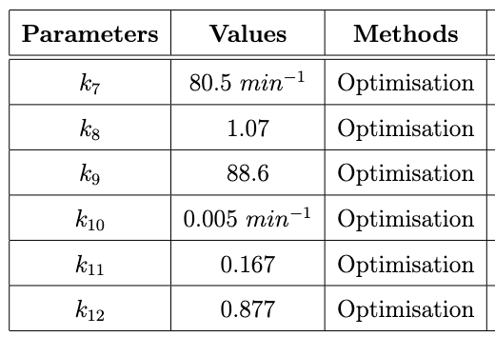
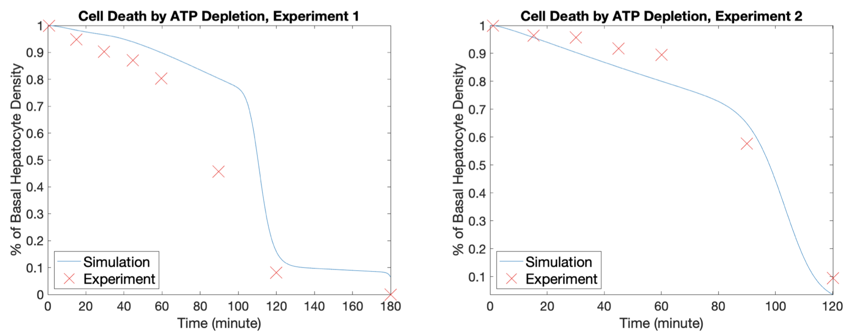
Parameterisation of Cell Density Submodel. Selected goodness-of-fit plots are shown
Parameters were fitted using in-virtu rat hepatocyte data from Redegeld 1990 and Redegeld 1992 (ATP vs. time, viability vs. time)
Two Hill equations have different scales (k7 and k10), as expected

Slide 25
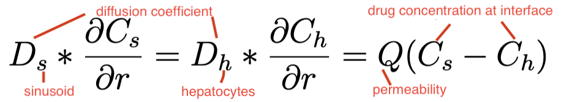
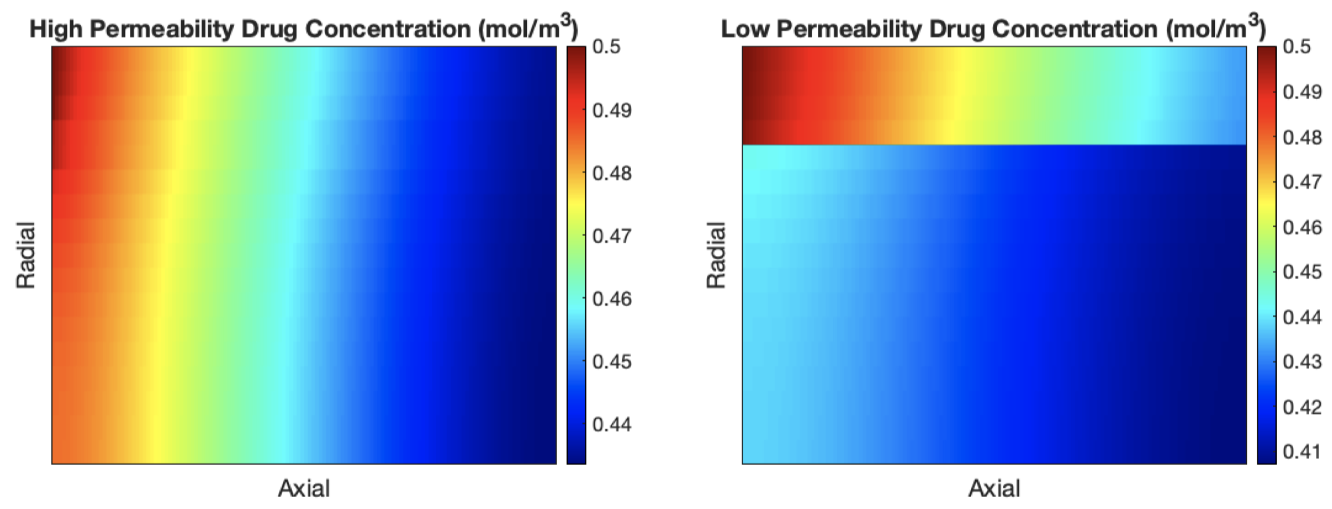
Drug Submodel includes 3 possible options
1. Continuous Spatiotemporal Drug Gradient With gradient: the setup is the same as Oxygen Submodel, except an extra permeability coefficient at the interface. Selected outputs of drug with different permeability are shown

Slide 26
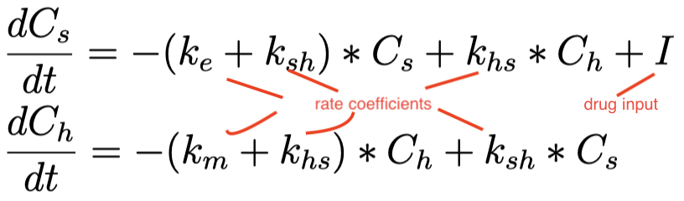
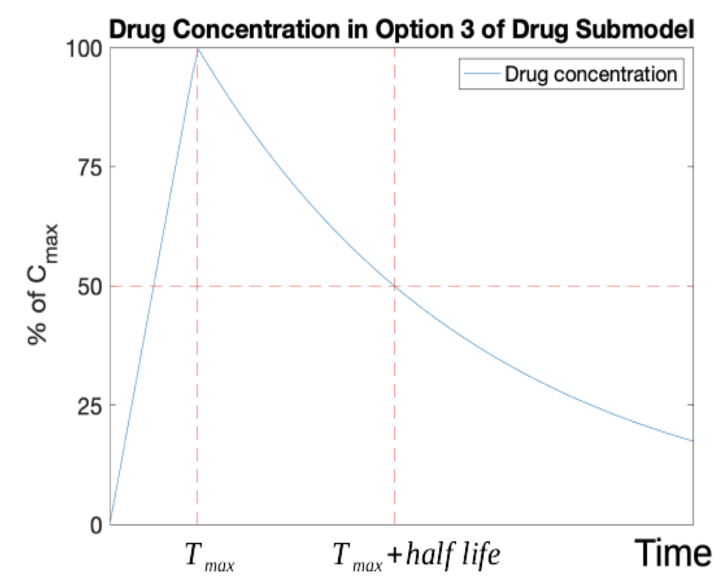
2. Two-Compartment Model: there is no drug gradient, only two compartments: sinusoid (central) and hepatocytes (peripheral)
3. One-Compartment Model: hepatocytes domain is the only compartment. Drug concentration increases linear to reach C_max after time T_max, then drops exponentially with a fixed half life.
This option is selected for the following simulations due to availability of data

Slide 27
Toxicity Simulations by SysDILI

Slide 28
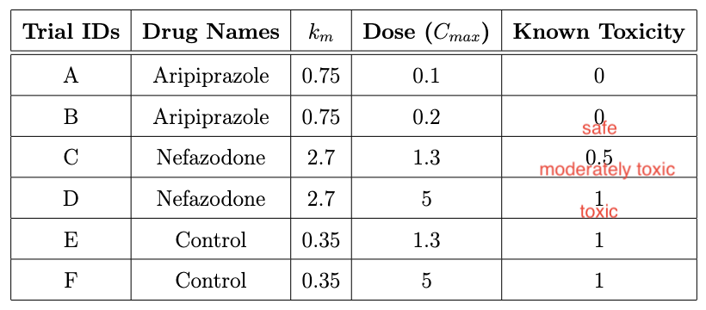
ETC inhibition was the selected mechanism to test the toxicity simulation of SysDILI
The table summarises drugs and doses used in simulations
T_max = 2 hours and half life of 4.5 hours were used in all trials for comparison

Slide 29
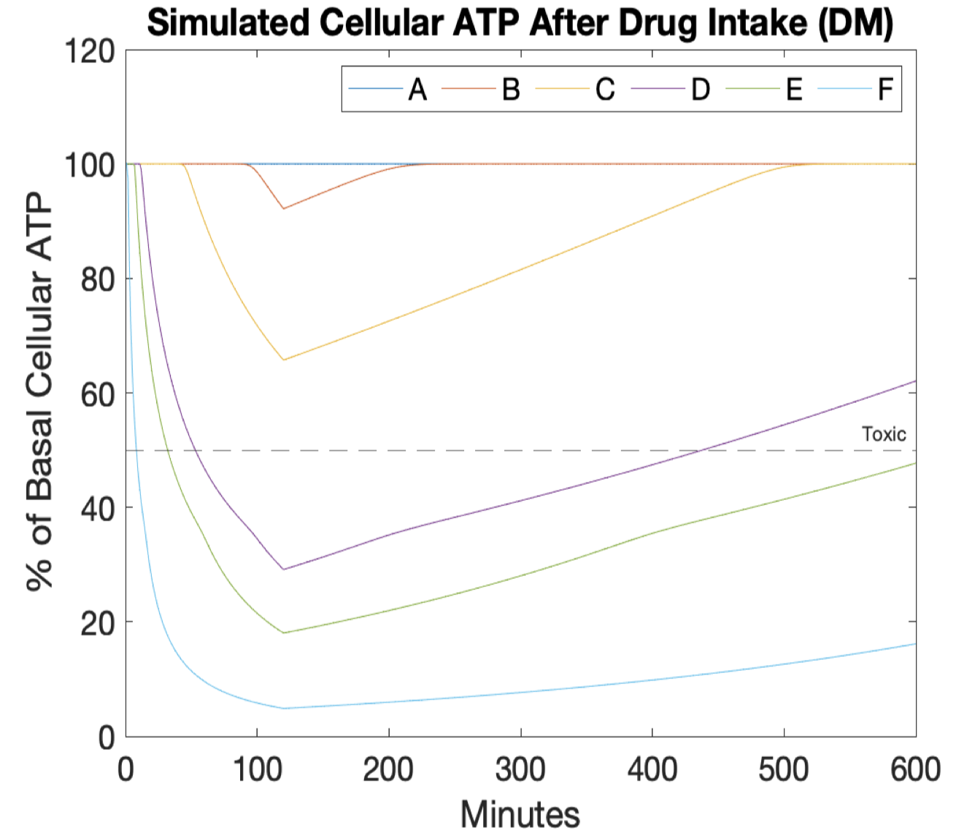
Drug+Mitochondria (DM): oxygen level is fixed and there is no spatial information
Cellular ATP level is used as surrogate for cell viability
Cellular ATP < 50 % of basal implies toxicity, as it marks the onset of immune mediated induced necrosis by TNF-α
Predictions are correct except Trial C , which is supposed to be moderately toxic

Slide 30
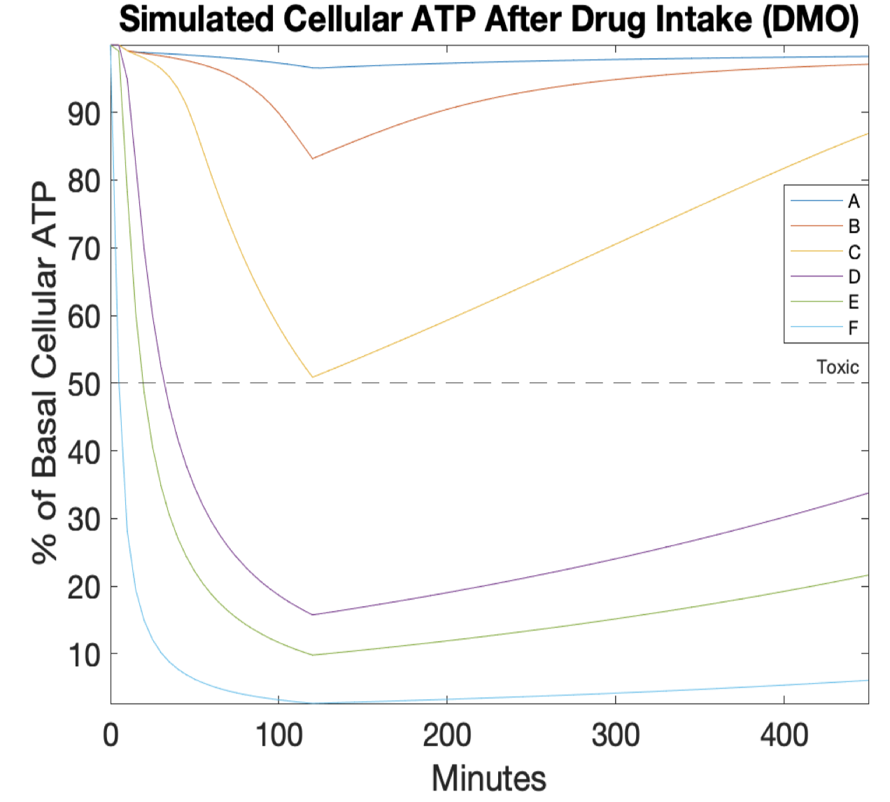
Drug+Mitochondria+Oxygen (DMO): continuous oxygen gradient affects mitochondrial activities
Adding spatial gradient from Oxygen Submodel improves the result of Trial C
Spatially discretised domain setup of Oxygen Submodel was used
Each discretised point gets an independent copy of ODE-based Mitochondria and Drug Submodels

Slide 31
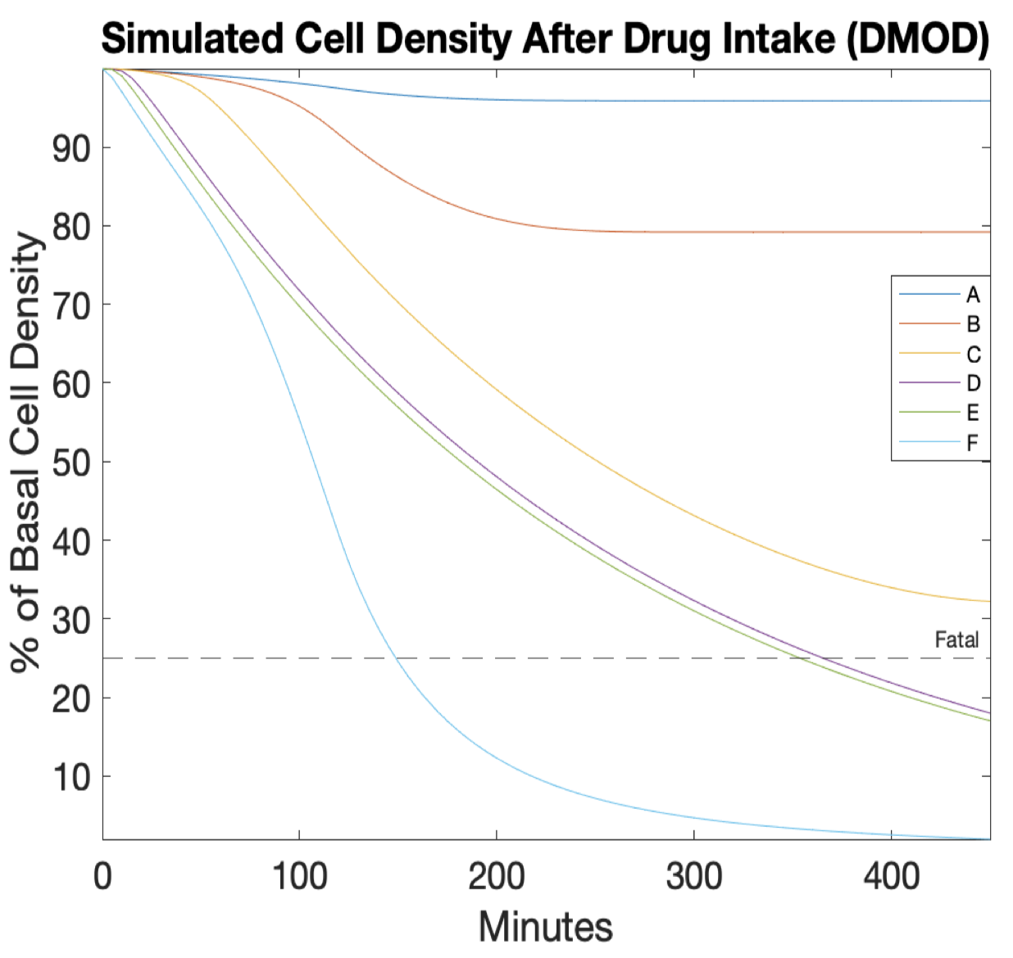
Drug+Mitochondria+Continuous Oxygen+Cell Density (DMOD): cell density gradient affects oxygen gradient
Average cell density <25% of basal is considered fatal damage

Slide 32
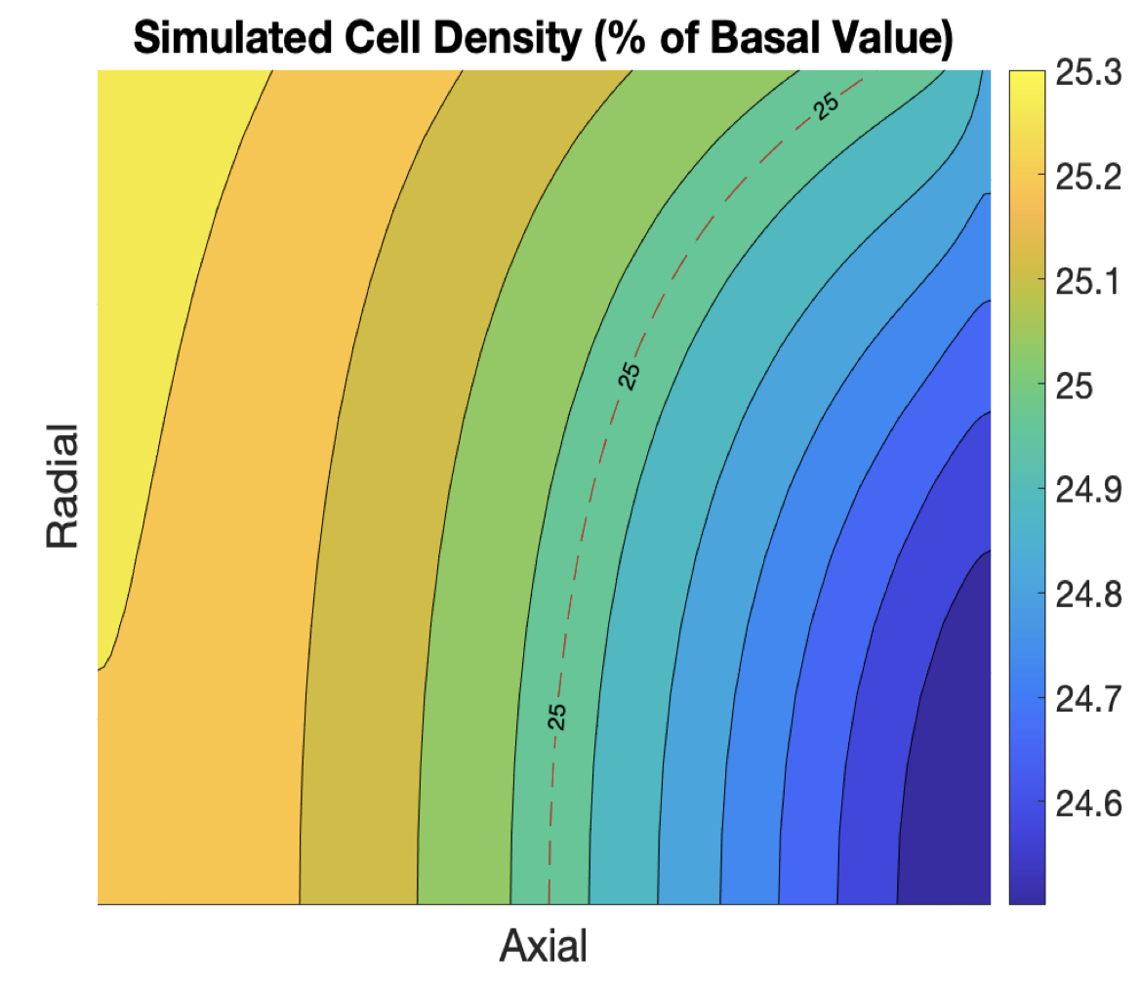
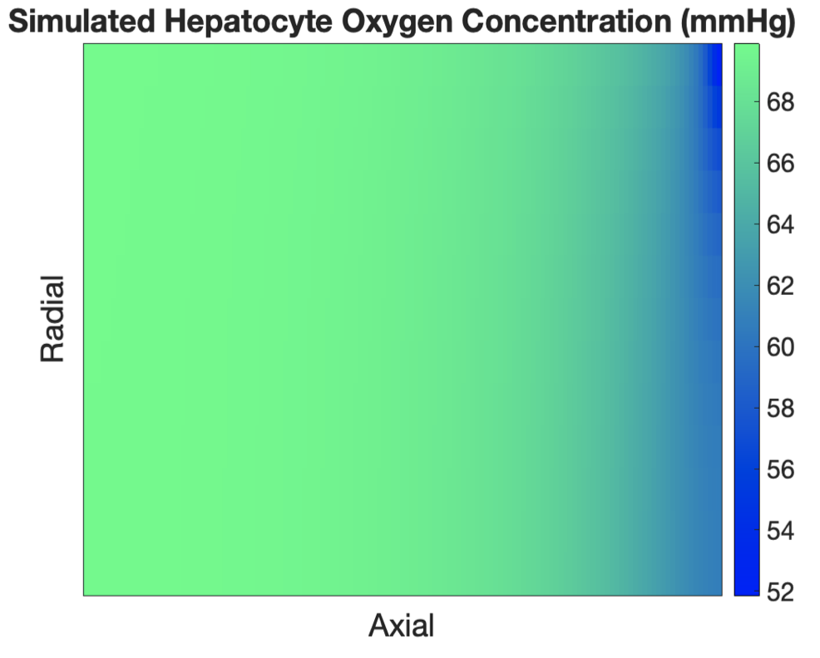
Selected gradient plots from DMOD trials are shown
Cell Density gradient of Trial D after 365 minutes. Vulnerability of Zone 3 can be seen
Hepatocyte Oxygen Concentration of Trial F after 450 minutes. Oxygen gradient is mostly lost due to severe DILI, as expected

Slide 33
Discussions
In SysDILI, glycolytic ATP gets inhibited together with mitochondrial ATP, leading to an overestimation of DILI, which is more acceptable than underestimation
Short term hepatocyte death in SysDILI might correspond to significant human DILI in longer term
Anaerobic respiration by glycolysis increases lactate level, whose buildup can also be toxic
Hepatocyte viability is more sensitive to depletion of glycolytic ATP than mitochondrial ATP, due to subcellular localisation

Slide 34
Potential Improvements and Further Research
Cell Density Submodel might model longer term DILI with a more complex and mechanistic ODE system of regeneration, apoptosis and necrosis
The domain setup of Oxygen Submodel can be changed from human sinusoidal functional unit to liver MPS. Resources can be saved by narrowing down the range of drug dose for MPS experiments, using SysDILI toxicity predictions
More drugs with known T_max and half life can be simulated in Drug Submodel. With more information of drug metabolic rates and mechanisms, Option 1 can be used to simulate MPS

Slide 35
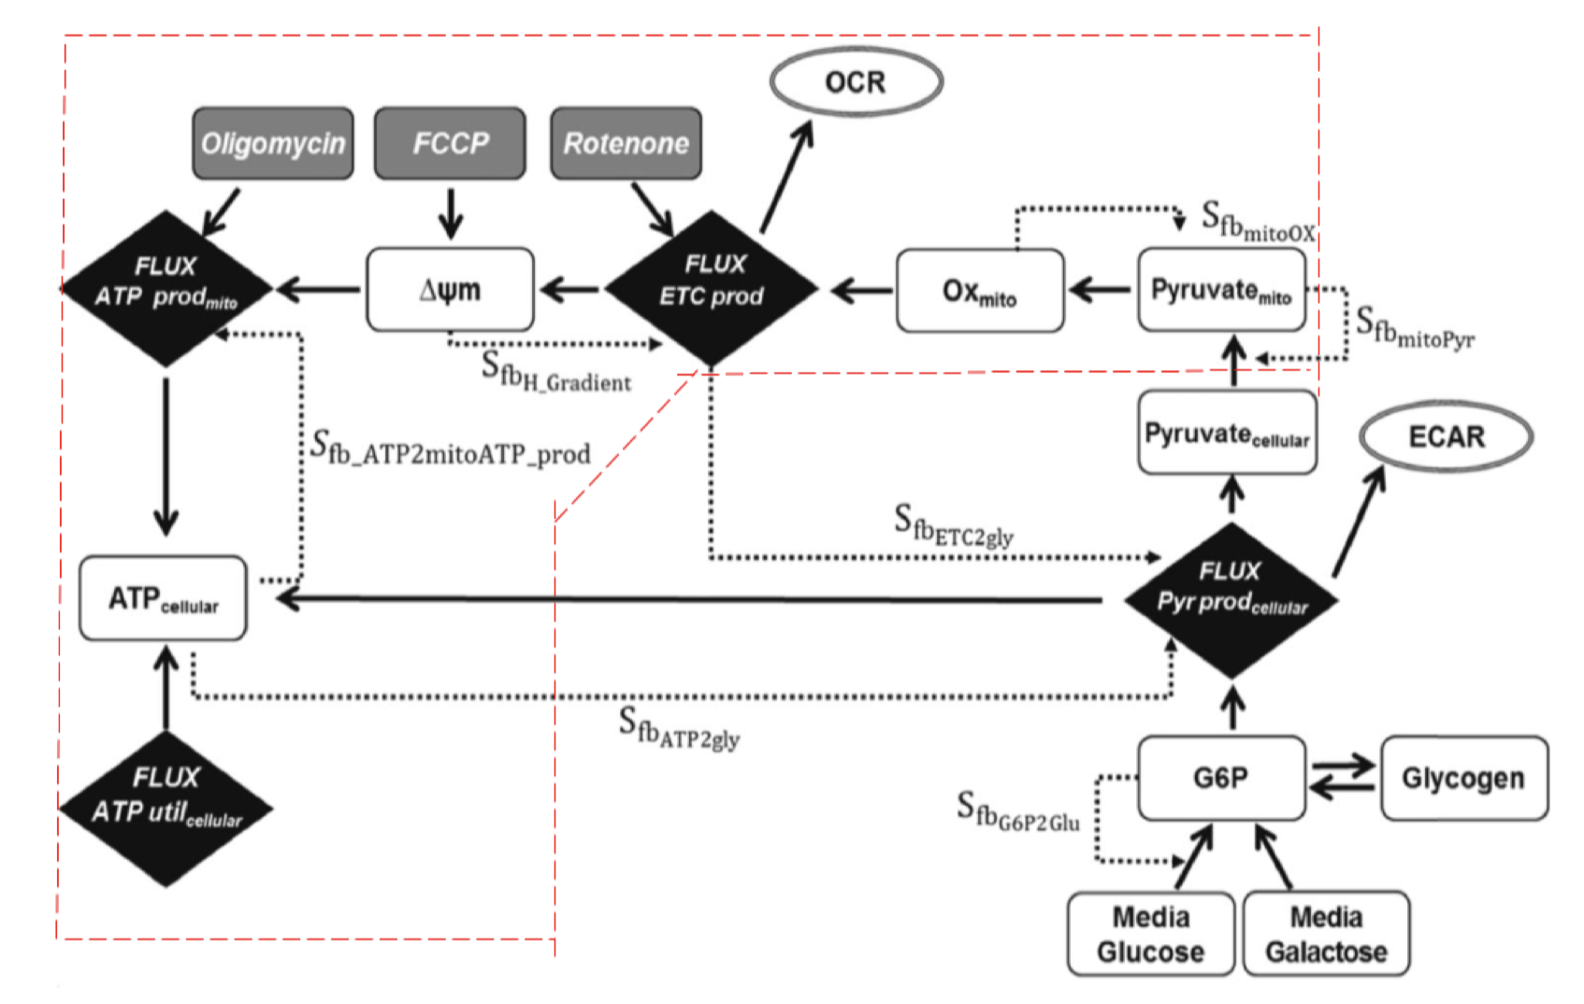
Schematic diagram MITOsym in Yang 2015
The encircled part remains in SysDILI
The plan is to implement the entire model and add equations for lactate
Glycolytic and mitochondrial ATP can be treated separately for a better model of cell death
Sensitivity analysis of all parameters is planned

Slide 36
Thank you for listening! Q & A

